Slide 1
CPE 186 Project #1: PCI Arbiter
By Miguel Tirado, Sam Lee, Jesus Nunez, Angel Smith Evans, and Mujeeb

Slide 2
What is a PCI Arbiter?
A PCI Arbiter performs bus arbitration to control which bus master gets access to the bus for a period of clock cycles
A PCI Arbiter has important signals which grants access to the current bus master to be able to write to the bus until the next bus master’s turn

Slide 3
Design Strategy
Our first task when designing the bus arbiter was to plan ahead and break it down in parts
We created a diagram for FSM and had used the diagram provided as a guideline
We broke this project down to two main parts the FSM machine and the counter

Slide 4
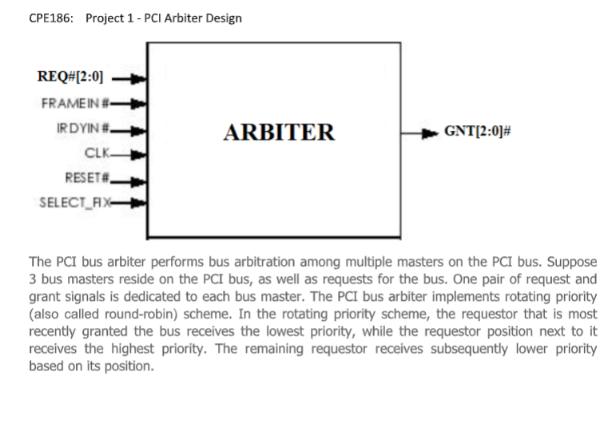
Design Strategy

Slide 5
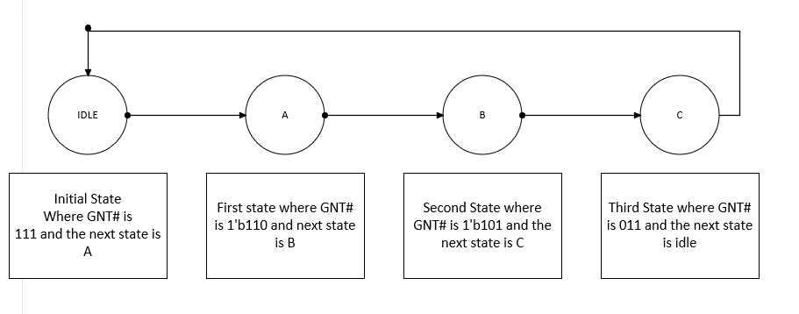
Implementation Of The FSM
When we implementing our FSM our first task was to create a flow chart of how we want our State machine to work.
This was a rough draft for how we designed our FSM.

Slide 6
Implementation
module Arbiter(clk,reset,req,frame,irdy,gnt);
input clk, reset, frame, irdy;
input [2:0] req;
output [2:0] gnt;
reg [2:0] gnt;
reg [1:0] cs, ns;
reg [3:0] timer;
reg [2:0] timer2;
parameter idle = 0, a = 1, b = 2, c = 3;
always @(negedge reset or posedge clk)
begin
if(reset == 0)
cs <= idle;
else
cs <= ns;
end
always @(cs or req)
begin
case(cs)
idle:
if(req[0] == 1'b0)
ns = a;
else if (req[1] == 1'b0)
ns = b;
else if (req[2] == 1'b0)
ns = c;
else
gnt = 3'b111;
a: if(req[0] == 0) begin
if(frame == 0) begin
if(irdy == 0) begin
ns = b; //a
gnt[0] = 0;
gnt[1] = 1; // test
gnt[2] = 1; //
end
else begin
ns = b;
end
end
end
b: if(req[1] == 0) begin
if(frame == 0) begin
if(irdy == 0) begin
ns = c;
gnt[1] = 0;
gnt[0] = 1;
gnt[2] = 1;
end
else begin
ns = c;
end
end
end
c: if(req[2] == 0) begin
if(frame == 0) begin
if(irdy == 0) begin
ns = idle;
gnt[2] = 0;
gnt[0] = 1;
gnt[1] = 1;
end
else begin
ns = idle;
end
end
End
default:
begin
ns = idle;
end
endcase
end
endmodule

Slide 7
Test bench
module Arbiter_tb;
reg clk, reset, frame, irdy;
reg [2:0] req;
wire [2:0] gnt;
Arbiter g1(clk,reset,req,frame,irdy,gnt);
initial clk = 0;
always #10 clk = ~clk;
initial begin
frame = 1; irdy = 1; req = 3'b111; reset = 0;
#20 reset = 1;
#20 frame = 0;
#20 irdy = 0;
#20 req[0] = 0;
#20 req[0] = 1;
frame = 1; irdy = 1;//reset = 0;
//#20 reset = 1;
#20 frame = 0;
#20 irdy = 0;
#20 req[1] = 0;
#20 req[1] = 1;
#100
frame = 1; irdy = 1;
#20 frame = 0;
#20 irdy = 0;
#20 req[2] = 0;
#400 $stop;
end
endmodule

Slide 8
Implementation of Counter
When implementing the counter we had to create two counters one for 16 clock cycles and the other for 8 clock cycles.
This was the hardest part for us since there multiple conditions that we have to follow.
We decided to implement the counter within our arbiter in order to avoid making separate modules.

Slide 9
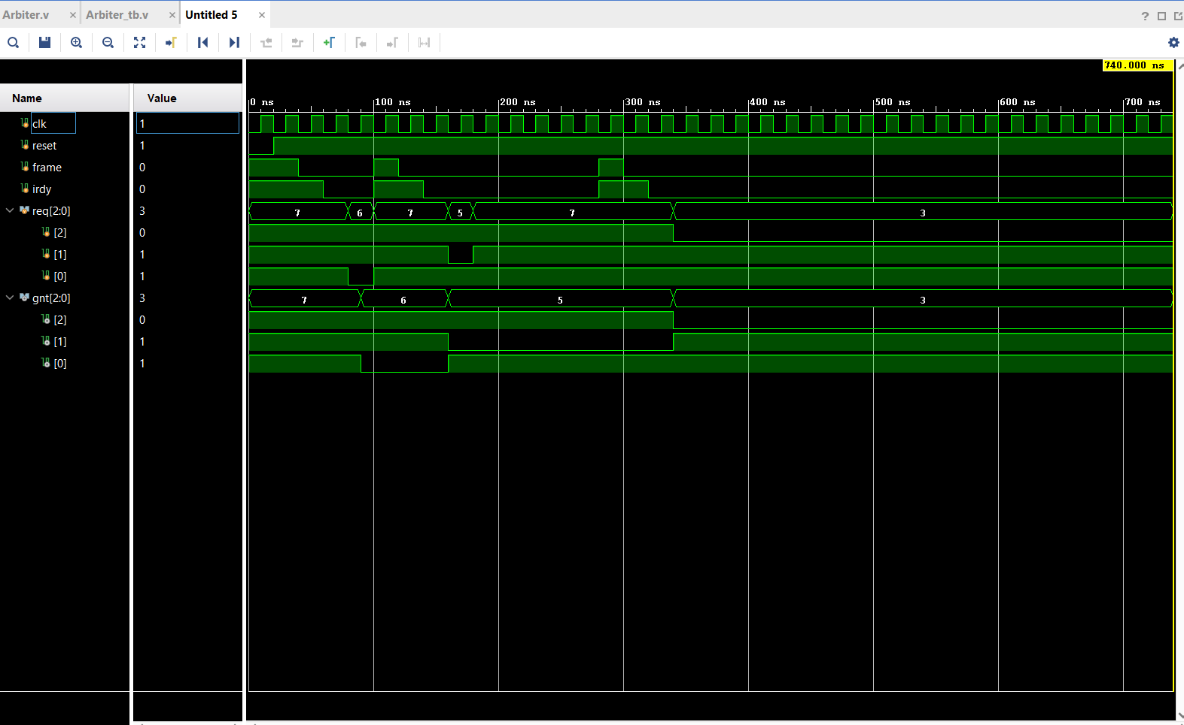
Waveform Simple Test
This is just a simple waveform that shows each state moving from idle to a to b to c and then all the way back to idle.

Slide 10
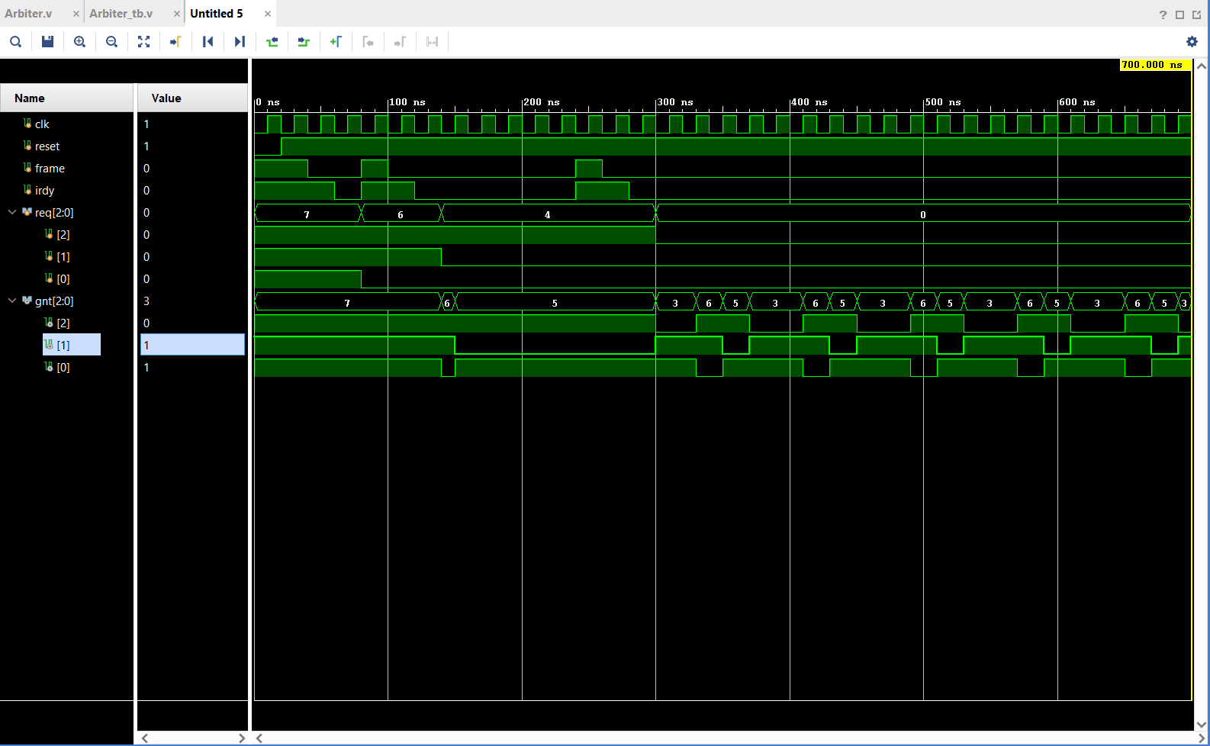
Waveform pt 2 Round Robin
In this waveform, idle state dictates A, B, and C. When A is deasserted, then its B’s turn to go on and shine, and when B is deasserted, C goes on and does the same as A and B, but B and A are off. Eventually when all request are asserted the arbiter will cycle through gnt A, B, C.

Slide 11
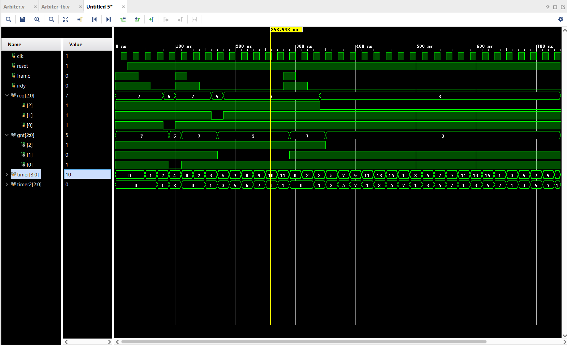
Waveform Counter
In this waveform, we have implemented the counters for 16 clock cycles and 8 clock cycles.
Timer represents the 16 clocks cycles
Timer2 represents the 8 clock cycles

Slide 12
Conclusion
This project was very confusing and hard at first because there was no code provided to guide us in it. But Dr. Pang told us to implement a finite state machine and from there we were able to create code based on that. A lot of us struggled with understanding the concept of a PCI arbiter, but through YouTube videos and Dr. Pang’s notes on it we were able to design the PCI arbiter in Verilog and create the waveform for it as well. It is not quite finalized yet due not having a counter that works that was supposed implemented in the design.

